Slide 1
Info Visualization
Drobnitchi Daniel-Nicusor,
Suto Robert-Lucian

Slide 2
The Dataset
1

Slide 3
The Dataset
The final dataset that we have chosen is comprised of two separate datasets, showing flight informations in 2015 and 2019 respectively. Those contain information about delays, cancellations, dates, distances and the companies that operated those flights.

Slide 4
The Dataset
The final dataset is structured on 32 columns and contains about 9 million rows of information. It is based only on US-based companies but contains national as well as international flights.

Slide 5
PowerBI Visualisations
2

Slide 6
PowerBI
For the POWER BI visualisation we used a trimmed version of the 2015 dataset, removing columns which didn’t have enough data, or columns which had erroneous data (E.g. :Airports using numbers instead of 3-letter abbreviations).

Slide 7
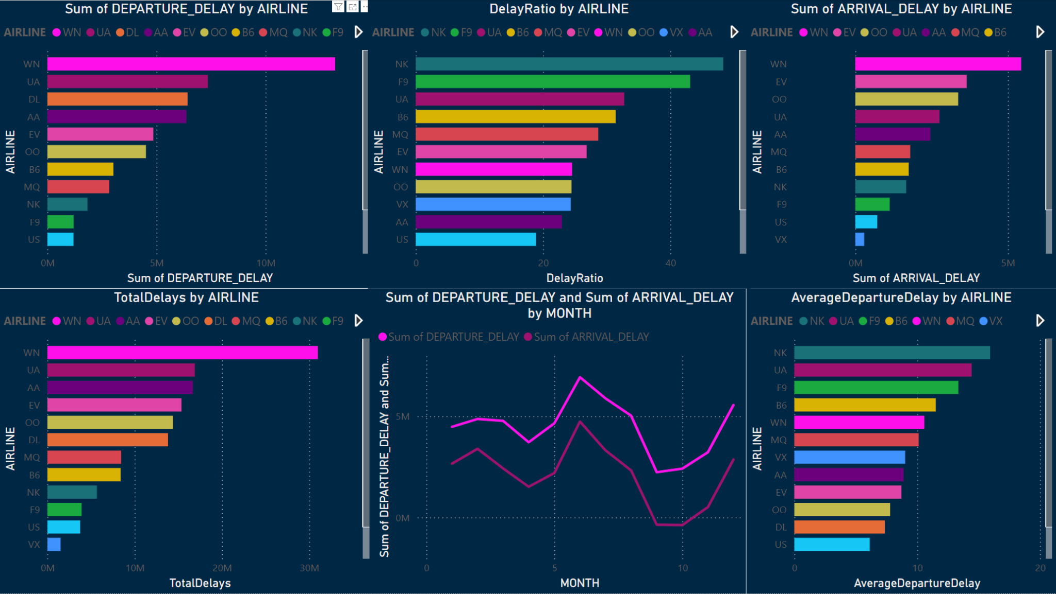
Delays Sheet

Slide 8
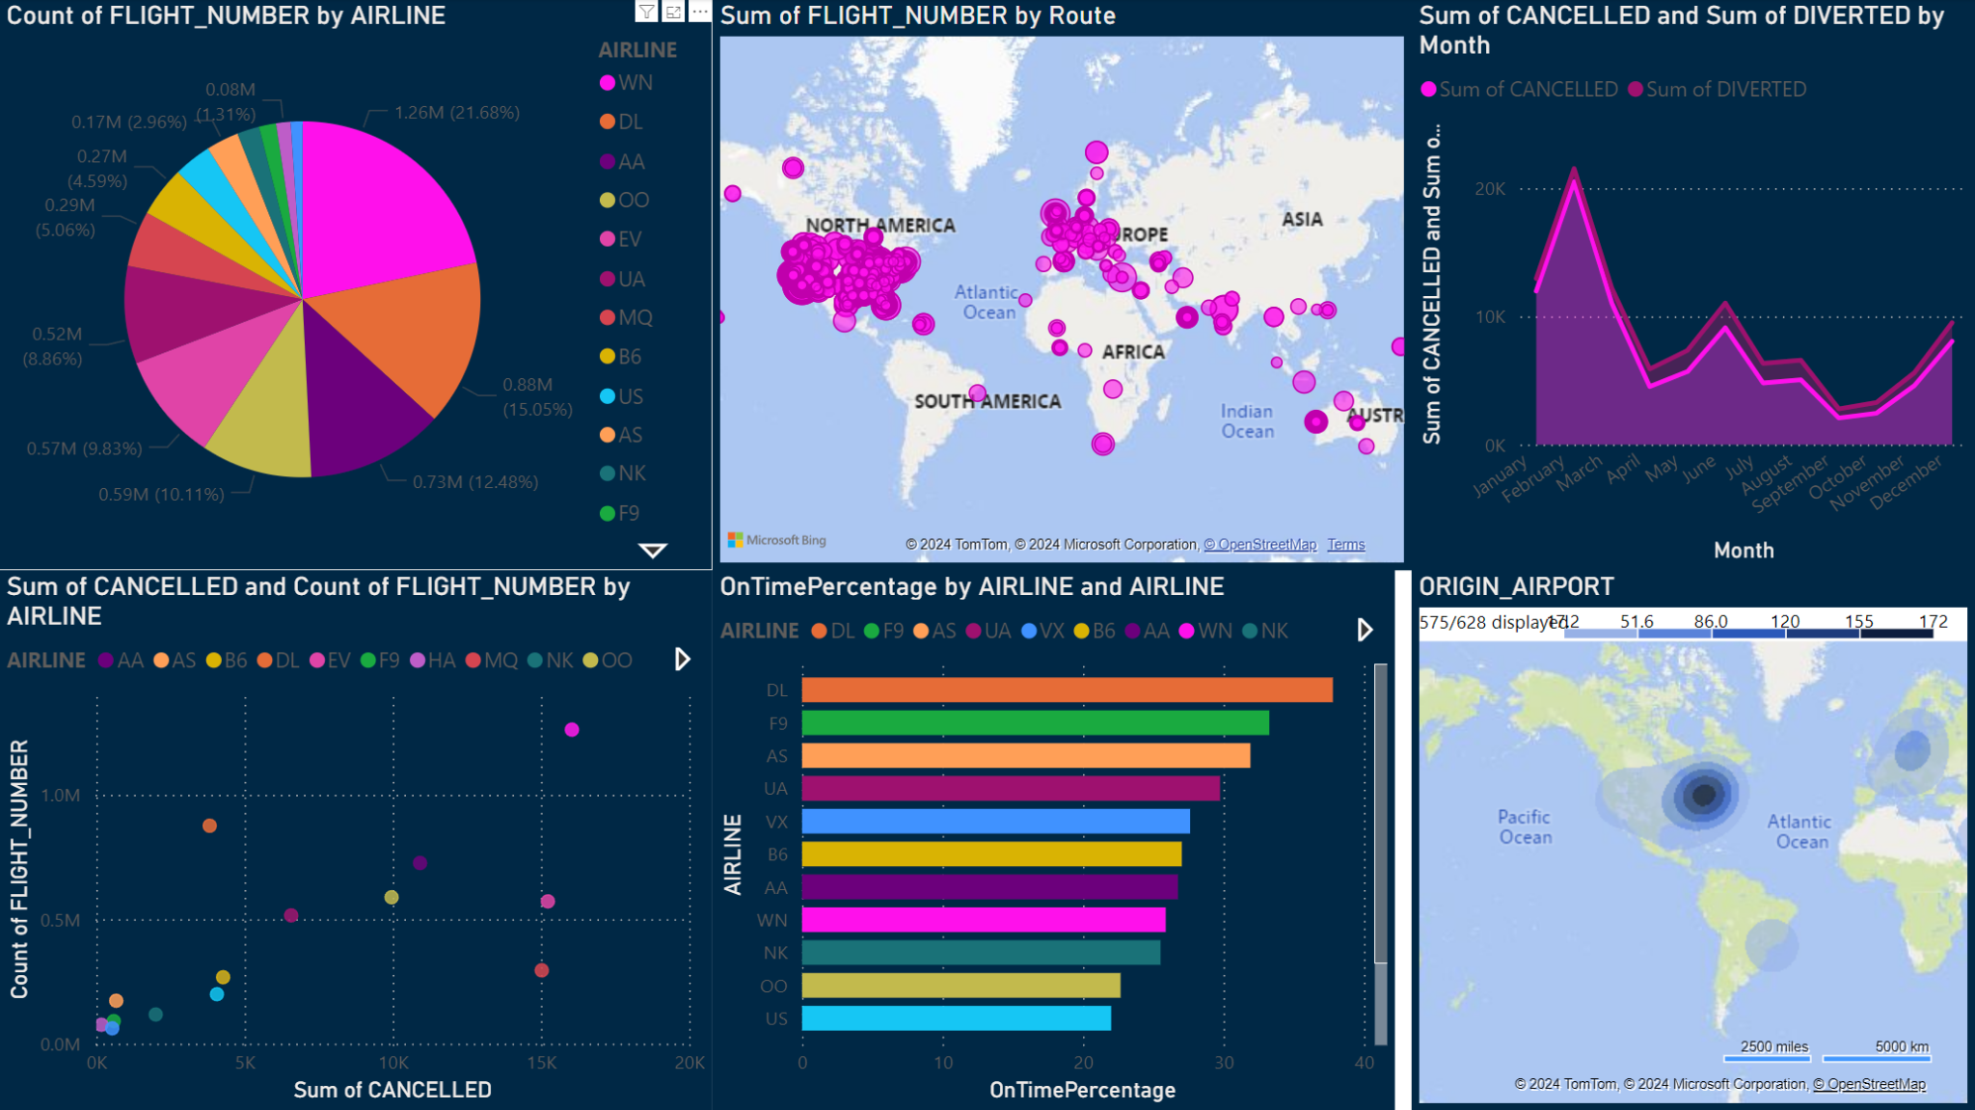
Stats Sheet

Slide 9
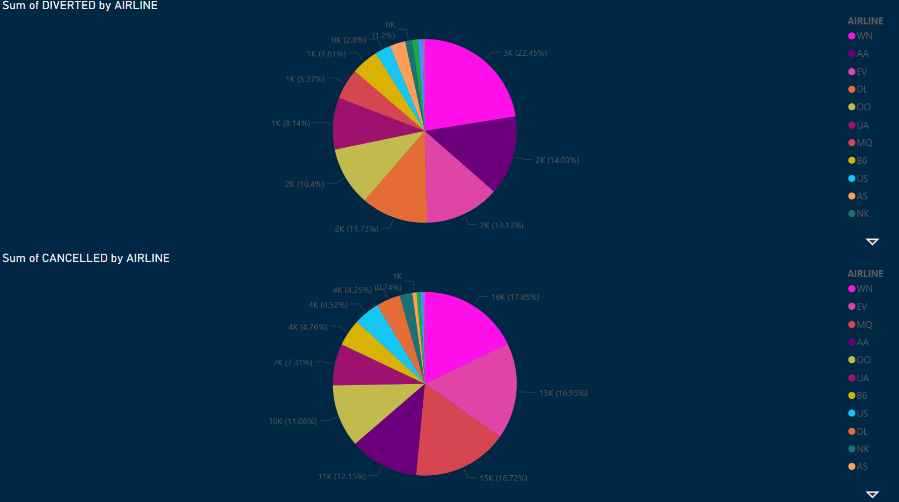
Diverted / Cancelled Sheet

Slide 10
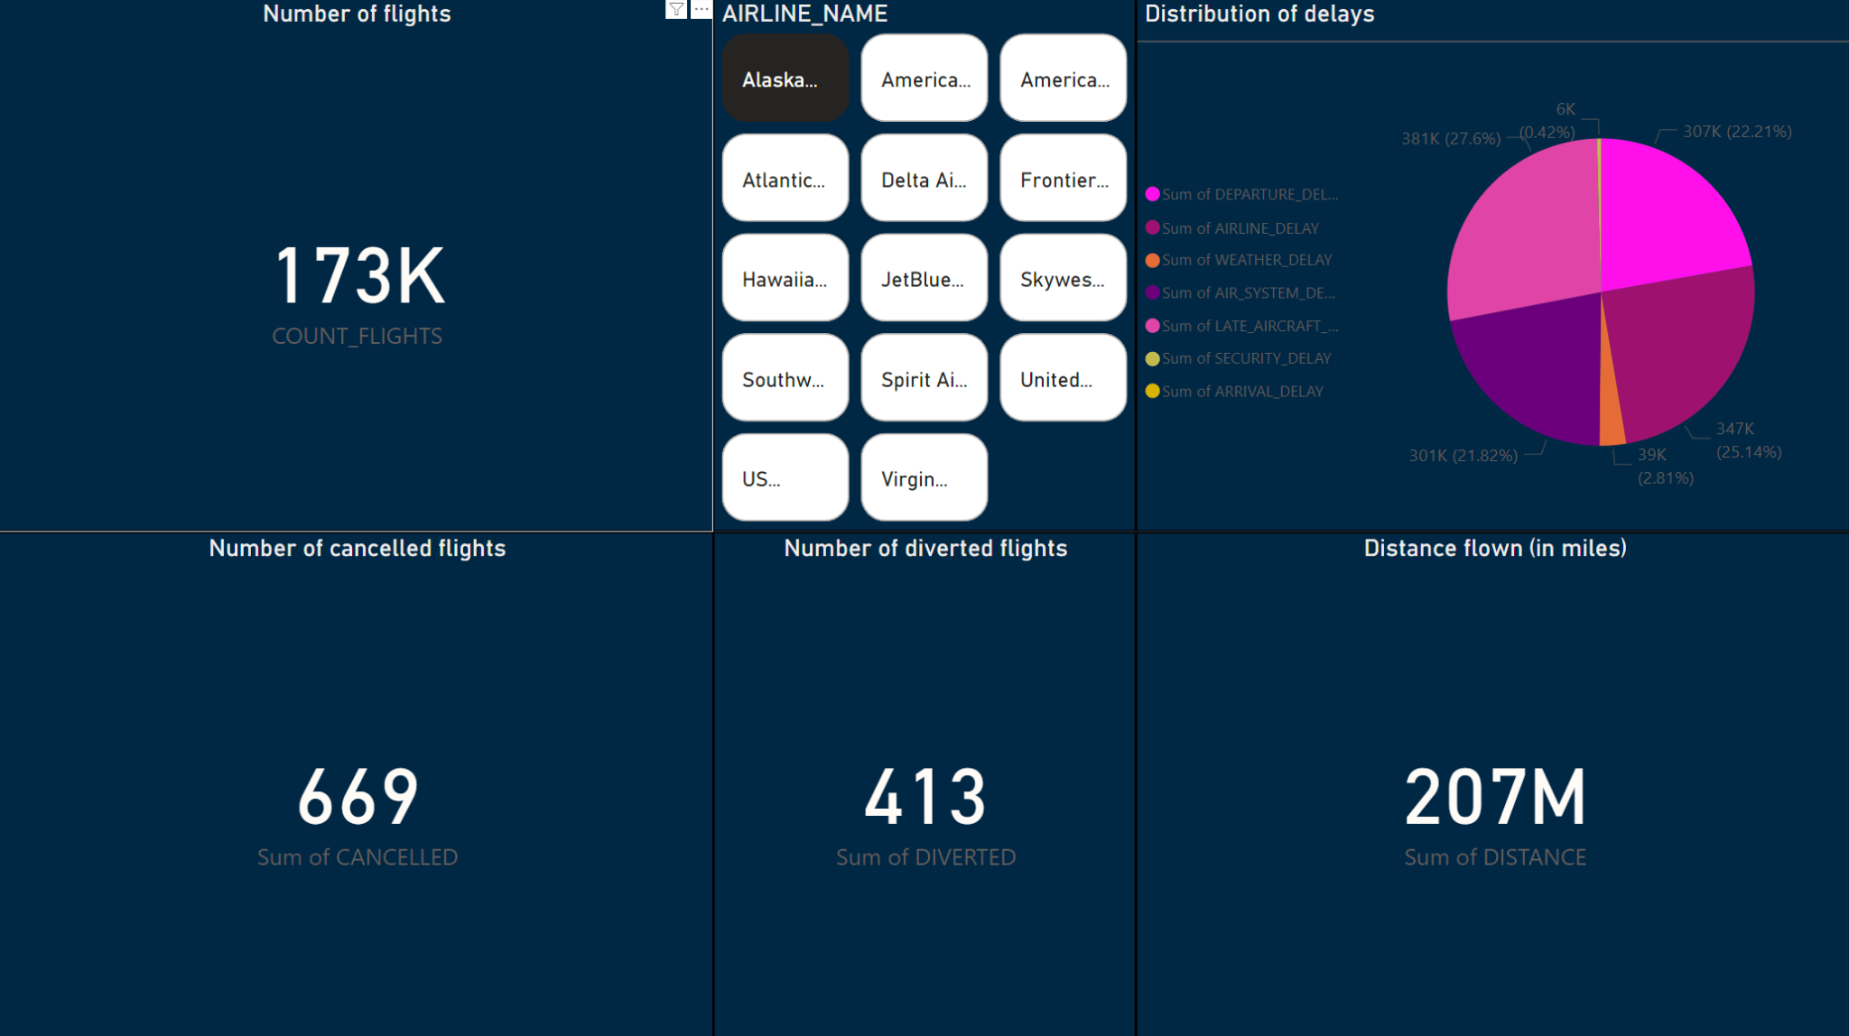
Airline Filter Sheet

Slide 11
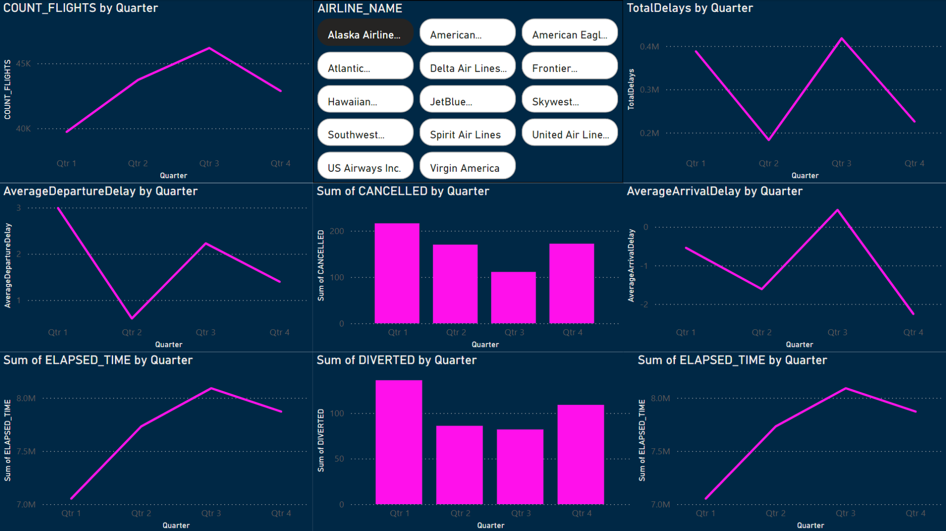
Quarterly Reports Sheet

Slide 12
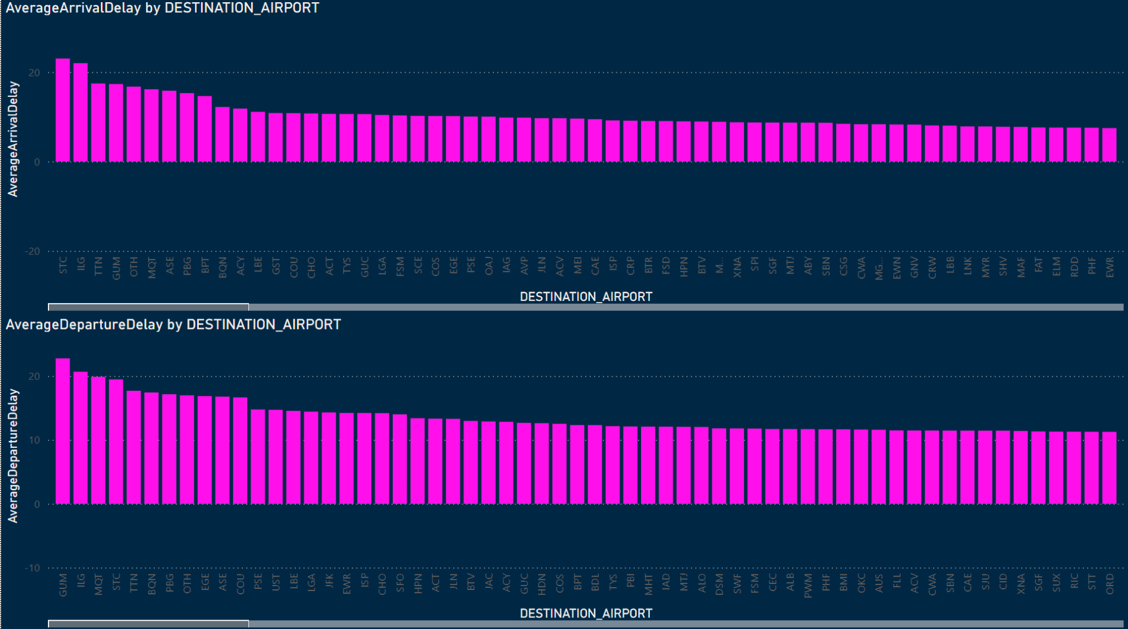
Airport Performance Sheet

Slide 13
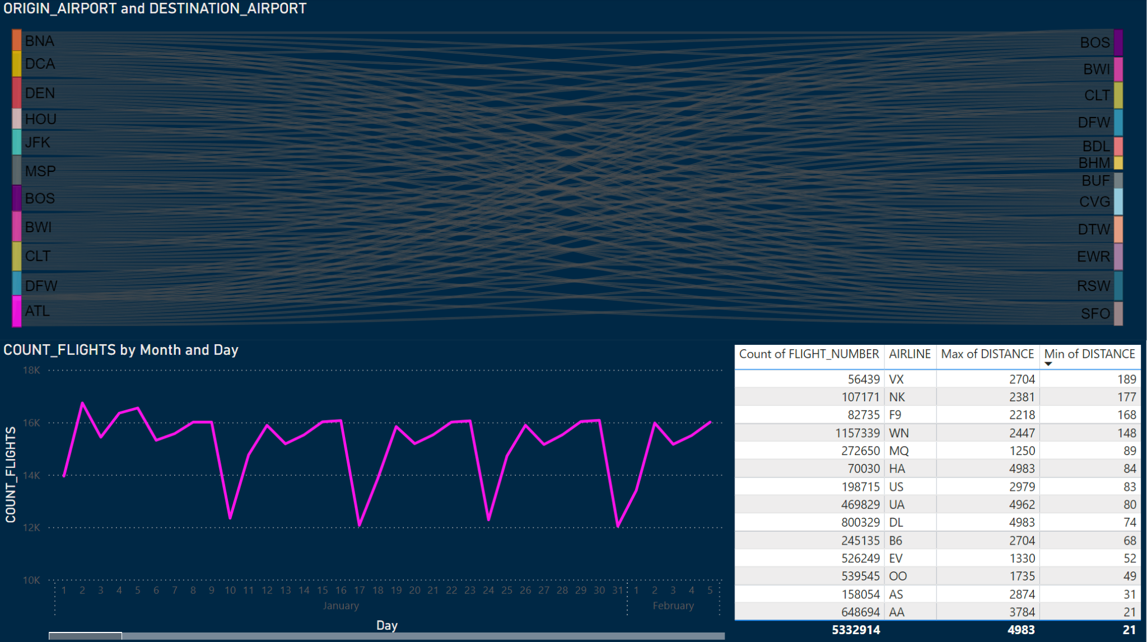
Fun Stats Sheet

Slide 14
Python Visualisations
3

Slide 15
Python Visualisations
The python visualisations included both datasets, after they have been cleaned of erroneous entries, empty rows and we kept only the relevant information for our graphs.

Slide 16
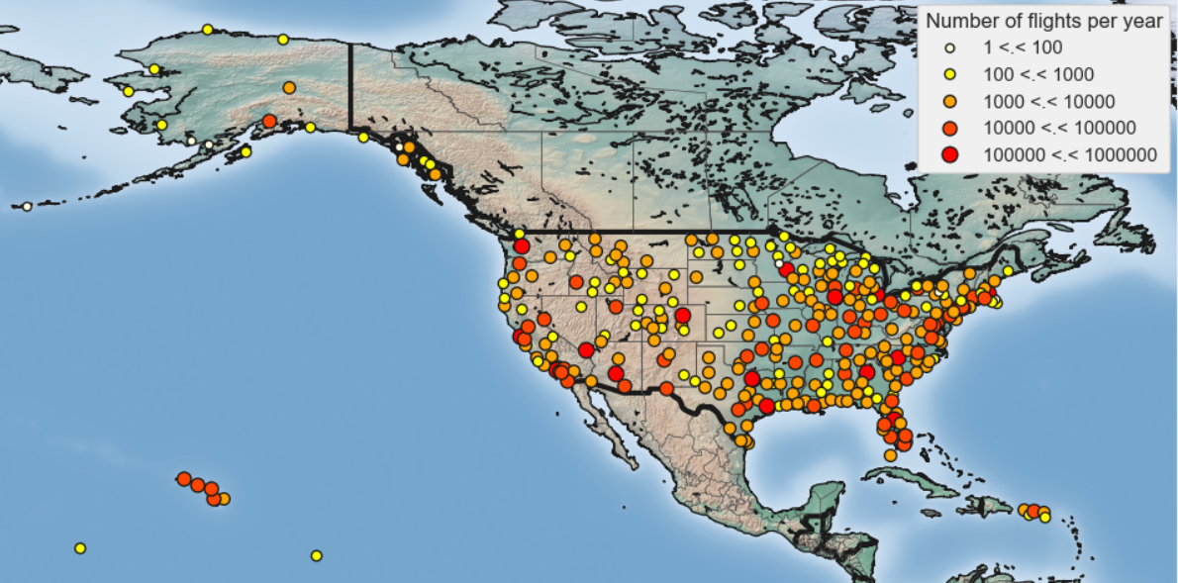
Basemap of flights

Slide 17
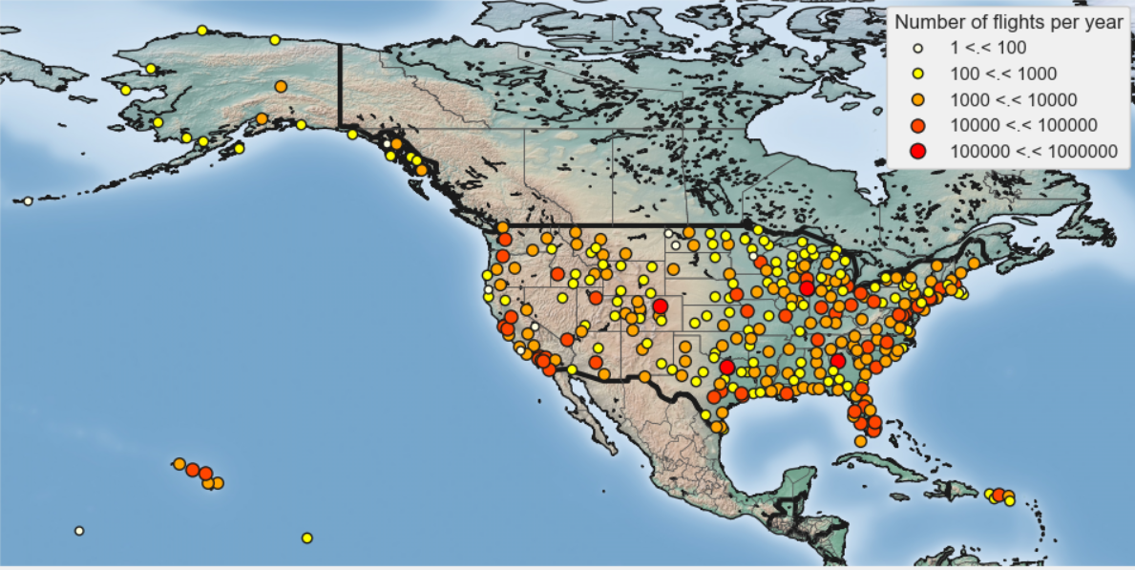
Basemap of flights

Slide 18
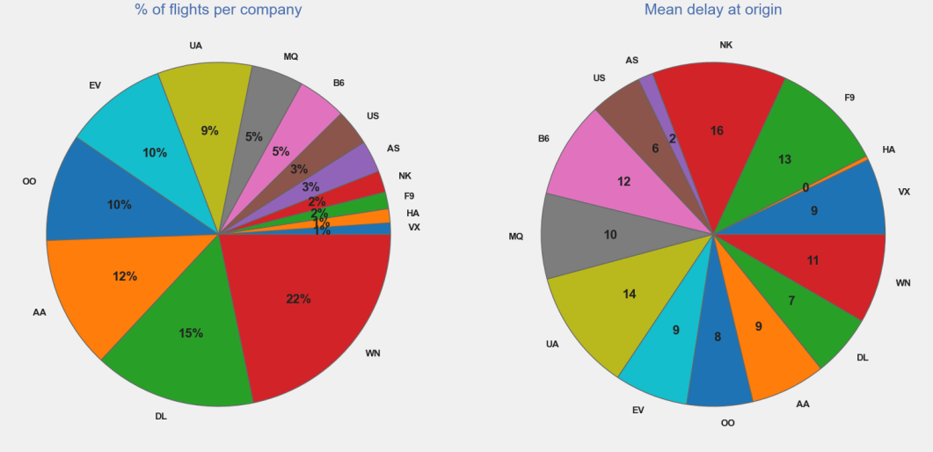
Flights, delays and companies

Slide 19
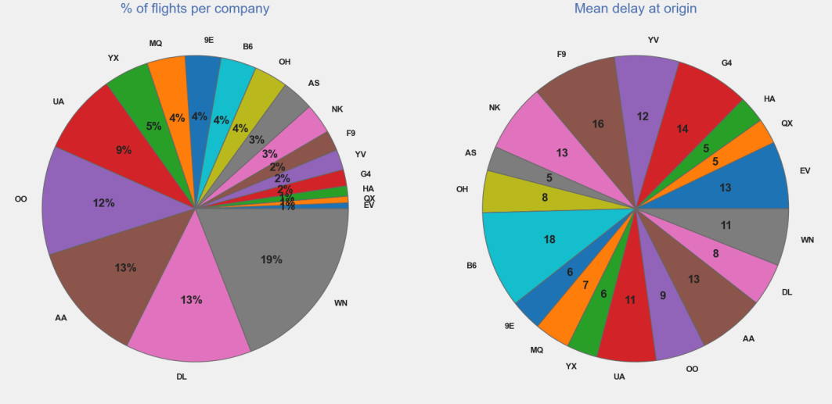
Flights, delays and companies

Slide 20
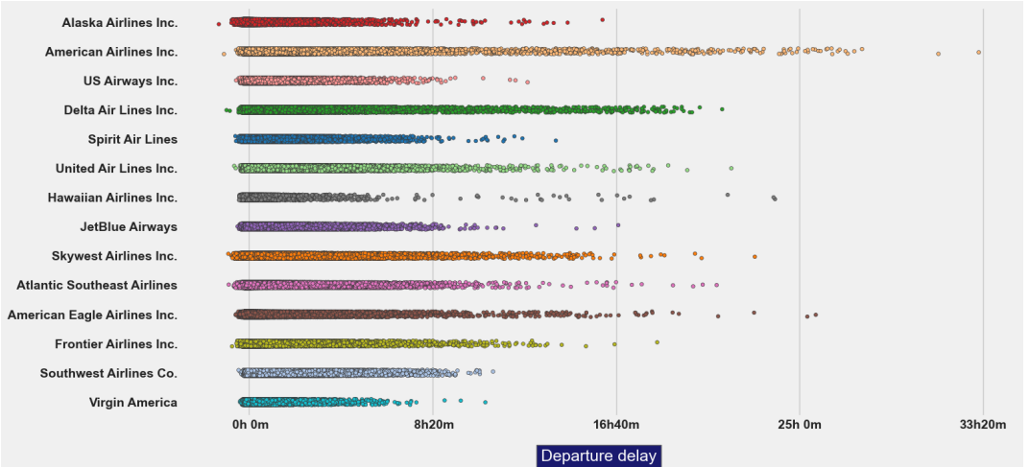
Flights, delays and companies

Slide 21
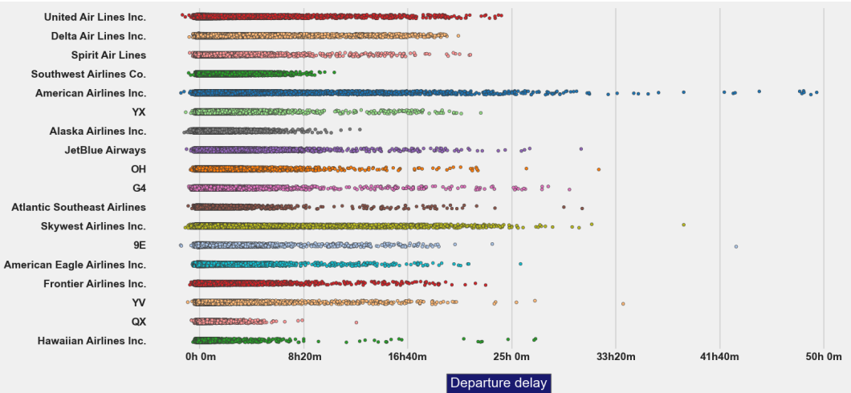
Flights, delays and companies

Slide 22
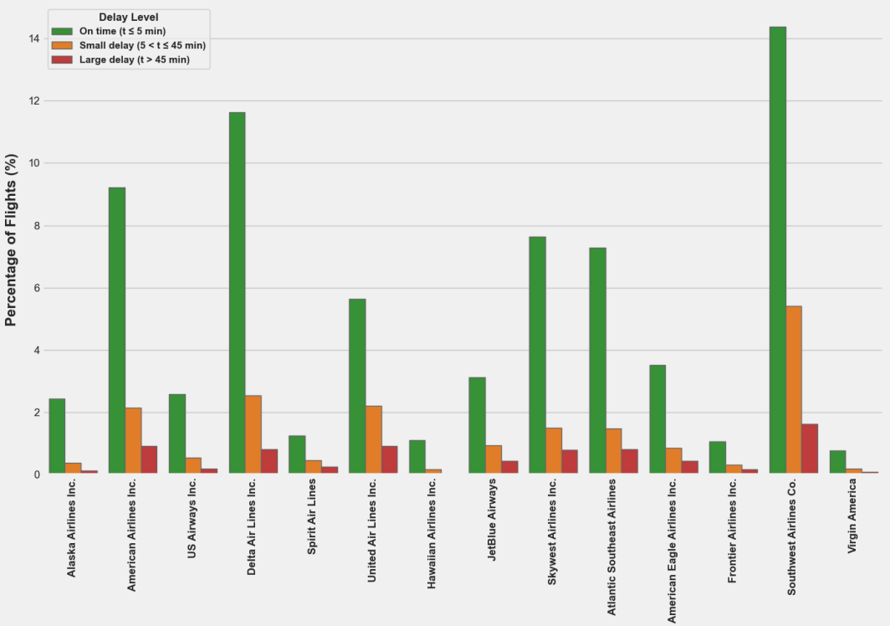
Delays compared to on time

Slide 23
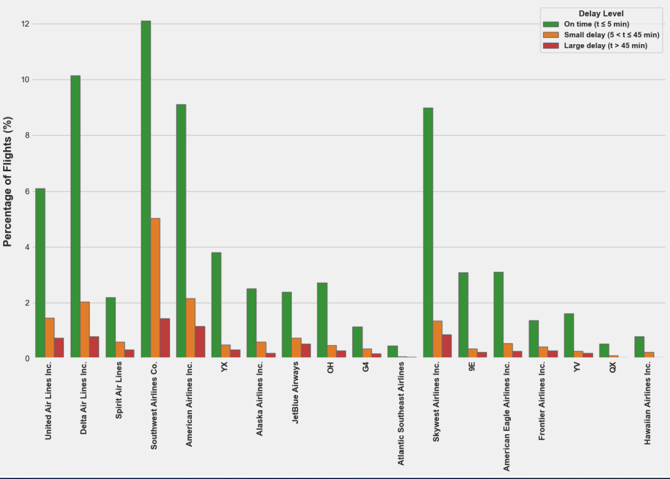
Delays compared to on time

Slide 24
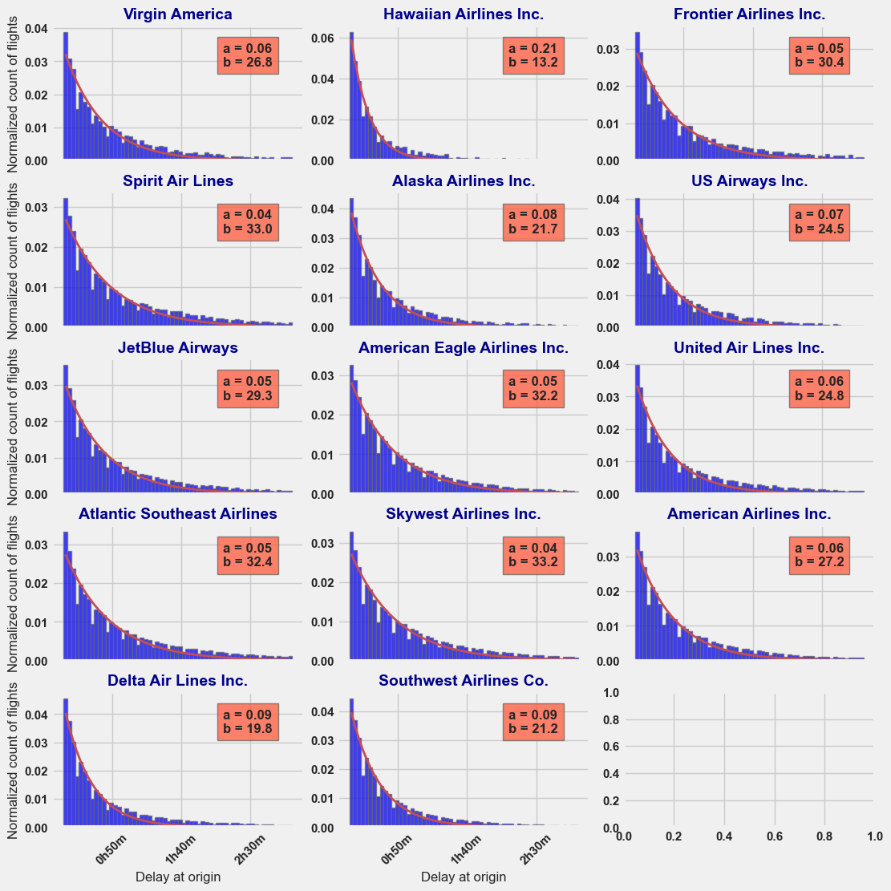
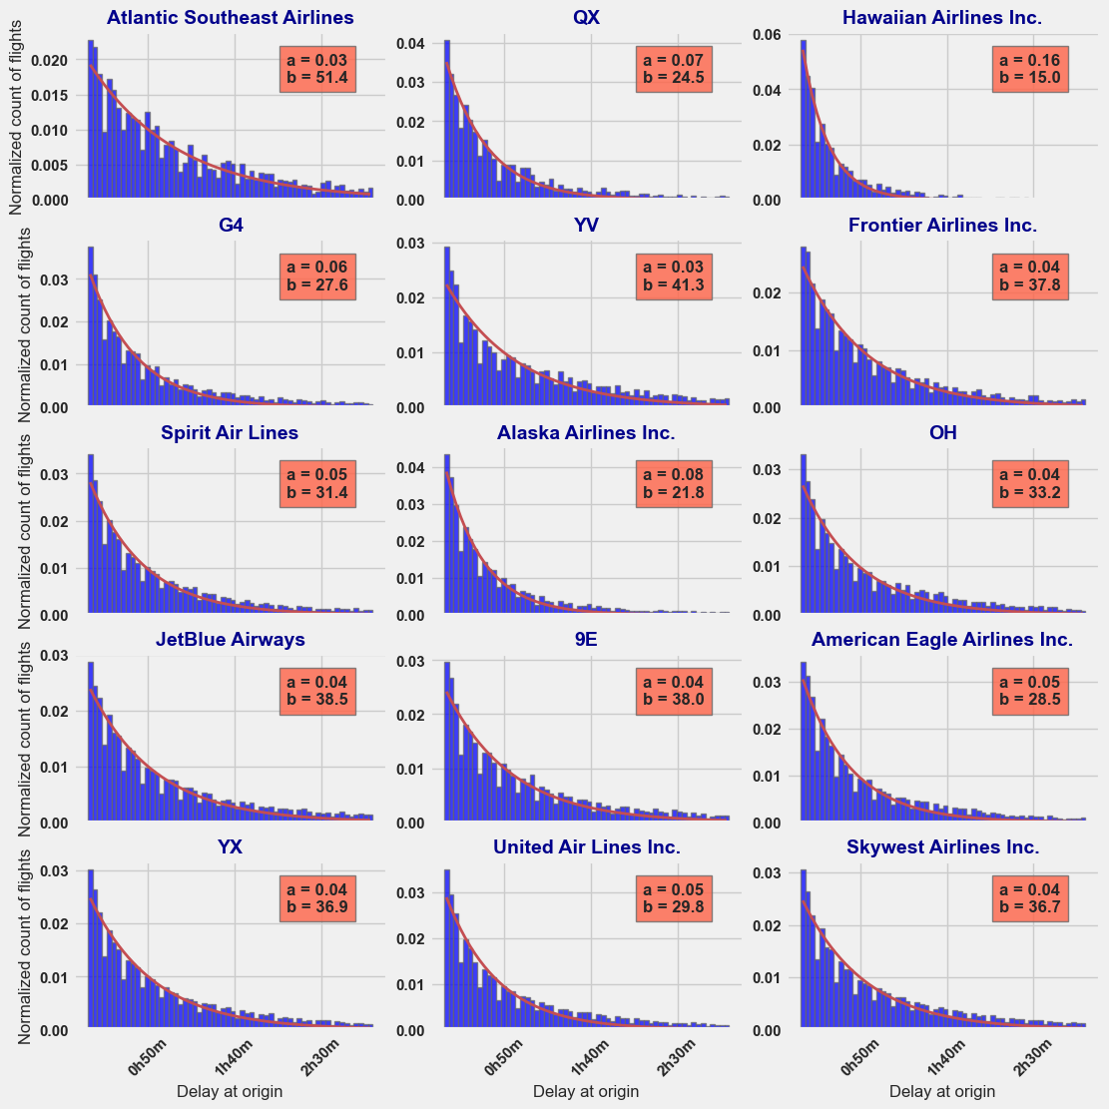
Delays compared to on time

Slide 25
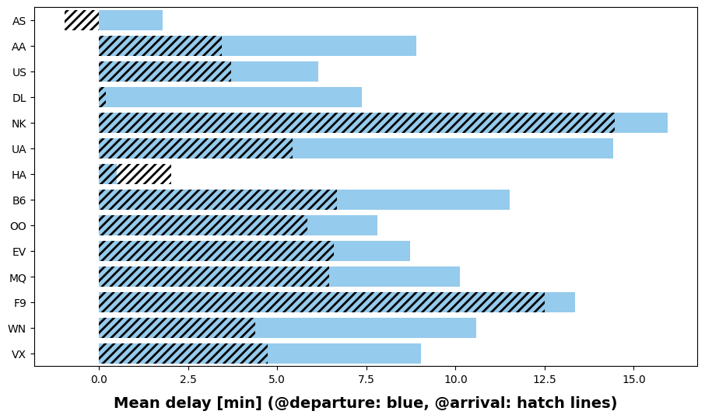
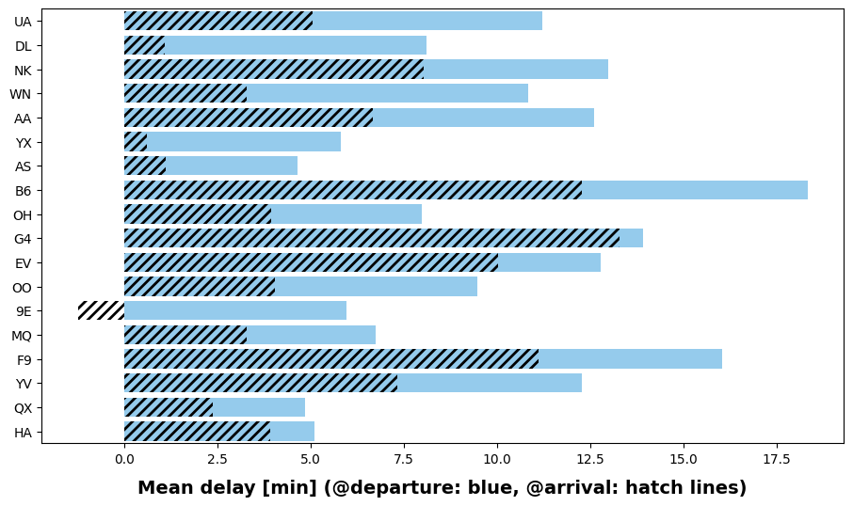
Delays on take-off vs landing

Slide 26
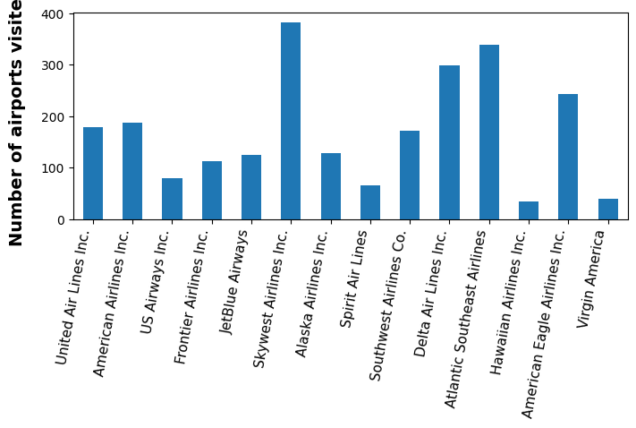
Relations between airport and delays

Slide 27
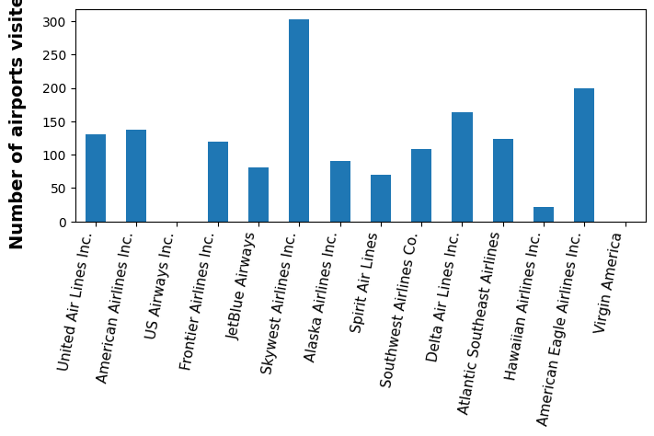
Relations between airport and delays

Slide 28
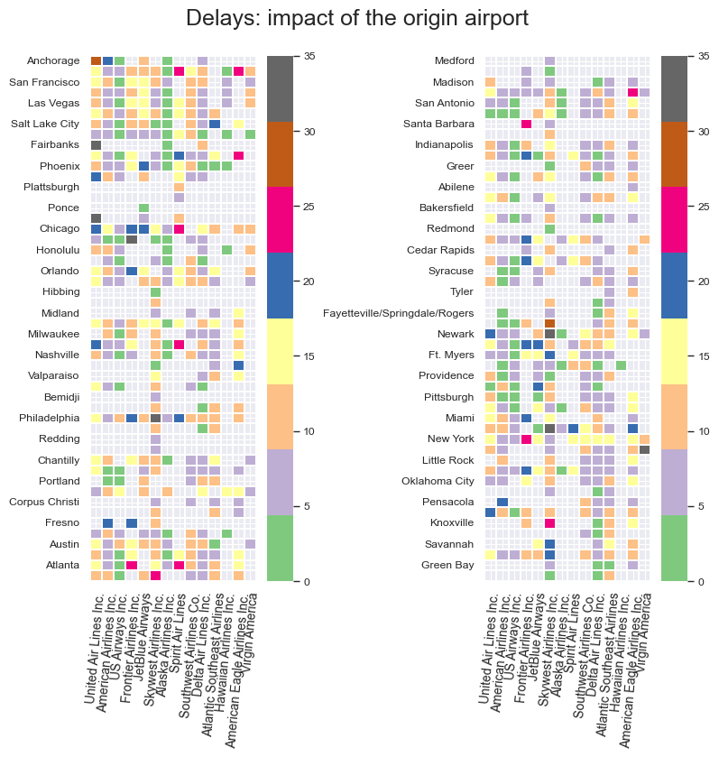
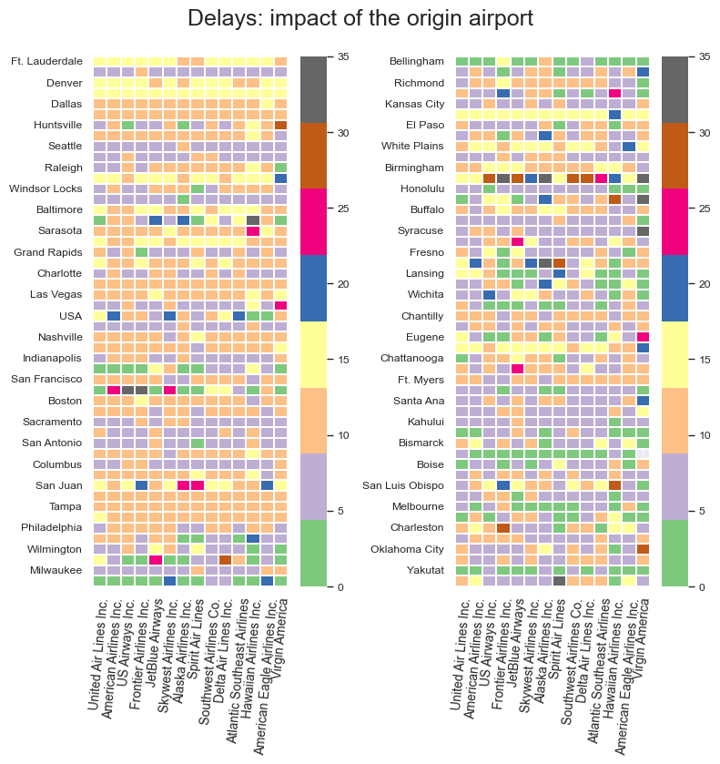
Relations between airport and delays

Slide 29
Thank you!
3

